Slide 1
Welcome Sisters!
Area 17
9/19/2020

Slide 2
Delta Kappa Gamma Legislative Platform 101
Presented by,
Heather Nonaca

Slide 3
Essential Questions for Today:
What is DKG’s Legislative Platform and how does it connect to the seven purposes of our organization?
How does Delta Kappa Gamma go about taking a position on a bill?
Who advocates/lobbies on behalf of Delta Kappa Gamma?
What’s happening currently at the state level with DKG’s stance on bills?

Slide 4
The History of the Platform
Established in May 1981
Many revisions since then (most recently in 2015)
Aligns with our 7 purposes
#4. To initiate, endorse and support desirable legislation or other suitable endeavors in the interests of education and of women educators
#7. To inform the members of current economic, social, political and educational issues so that they may participate effectively in a world society

Slide 5
DKG California seeks to initiate and support legislation in the following areas to support our purposes:
Equal Educational Opportunity for All
Curriculum and Instructional Development for Educators
Professional Standards
Employment Conditions
Financial Structure of Public Education

Slide 6
EQUAL EDUCATIONAL OPPORTUNITY FOR ALL
DKG California recognizes that the purpose of education is to enable individuals to become responsible, productive adults and to continue intellectual, personal and spiritual pursuits throughout their lifetimes. DKG California supports measures that will provide for:
1. A public education system from early childhood through higher education, including adult education.
2. Programs of instruction, guidance, and counseling to permit optimum development of abilities and skills.
3. Programs to encourage and make use of innovative methods to reach every child, building on the cultural backgrounds of all children.

Slide 7
CURRICULUM AND INSTRUCTIONAL DEVELOPMENT FOR EDUCATORS
DKG California recognizes that the California State Commission on Teacher Credentialing awards credentials and certificates based on completion of programs that meet Standards for Educator Preparation and Educator Competence. To that end, DKG California supports measures that will provide:
1. Programs to further teacher development for the fulfillment of their professional role in the education and well-being of youth.
2. Programs that will prepare teachers to assume responsibility for working with students, parents, policy makers, and the public in determining the goals and objectives of the schools.
3. Instructional materials and programs in curriculum planning and in the implementation of the educational program to achieve the goals and objectives of the schools.
4. Implementation of existing legislation to provide a safe and secure environment for students and school personnel
5. Legislation to promote alternative programs for educating at-risk students.

Slide 8
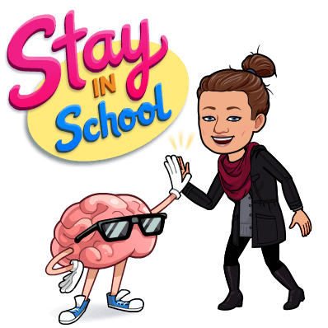
PROFESSIONAL STANDARDS
Every child has the right to be instructed by competent teachers. Maintenance of high standards for the teaching profession is essential, and DKG California supports measures to provide for:
1. Involvement of educators, including classroom teachers, in decisions concerning teaching credential requirements.
2. Teaching credential requirements to include a balance of courses in academic fields as well as instruction in physical, intellectual, emotional, and social growth and development of the learner as they apply to the role of the teacher.
3. Pre-service preparation requiring some courses, beginning no later than the sophomore year in college, which combine observation of and involvement with students of varying ages and instructional levels and include a variety of experiences with pupils from differing ethnic and socioeconomic backgrounds.
4. More emphasis on early screening of teacher candidates prior to entering training to determine their sensitivity to and understanding of human relations as well as their suitability for a teaching career.
5. Continuous evaluation of teacher-training candidates.
6. Early and continuous evaluation of teachers and administrators. In-service training designed with emphasis on knowledge, skills, and attitudes toward those they teach, and sensitivity to, and understanding of, human relations.
7. An orderly process for the release of incompetent and unsuitable educators.

Slide 9
EMPLOYMENT CONDITIONS
Agreements on employer-employee relations need to be made in an orderly manner. DKG
California supports measures that will:
1. Provide teachers a professional atmosphere in which to carry out their responsibilities to their students without undue or improper restraint, permitting them to present factual information on conflicting sides of controversial issues.
2. Protect by law the continued employment of competent teachers.
3. Safeguard, improve, and strengthen the State Teachers’ Retirement System.
4. Establish procedures whereby agreements concerning goals of the educational program, conditions and terms of employment, and the content and mode of instruction can be achieved in an orderly manner.

Slide 10
FINANCIAL STRUCTURE OF PUBLIC EDUCATION
Every student is entitled to a quality education. The burden of the financial structure of our system of education must lie with the state rather than local districts. DKG California State supports measures to provide:
1. The major financial burden of the cost of education to be borne by the state, equalizing contributions with consideration for the tax basis of local school districts.
2. State financial support for state-mandated programs.
3. Public funds allocated for education to be used for public schools only.
4. Funding for adult education to reach students of all socio-economic backgrounds.
5. A financial structure for the education system that includes a cost-of-living index escalation clause.

Slide 11
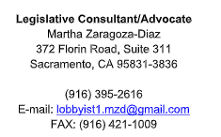
How do we take positions on bills?
The Legislative Consultant/Advocate screens bills as they are introduced in the Legislature and selects those of interest to DKG California
The Legislative Coordinator assigns bills to Bill Evaluators.
The Bill Evaluator analyzes all available information and makes a recommendation. Evaluators inform the Legislative Coordinator of their recommendation.
Legislative Coordinator reviews evaluations and submits recommendations to our Legislative Consultant/Advocate
Chairman: Kathy Kinley
dkgcaedlaw1@gmail.com Chapter: Epsilon Sigma
Our Legislative Coordinator:
Hazel Powell
dkgcaedlaw5@gmail.com Chapter: Theta Area: V teampowell@aol.com

Slide 12
What’s Happening Right Now?

Slide 13
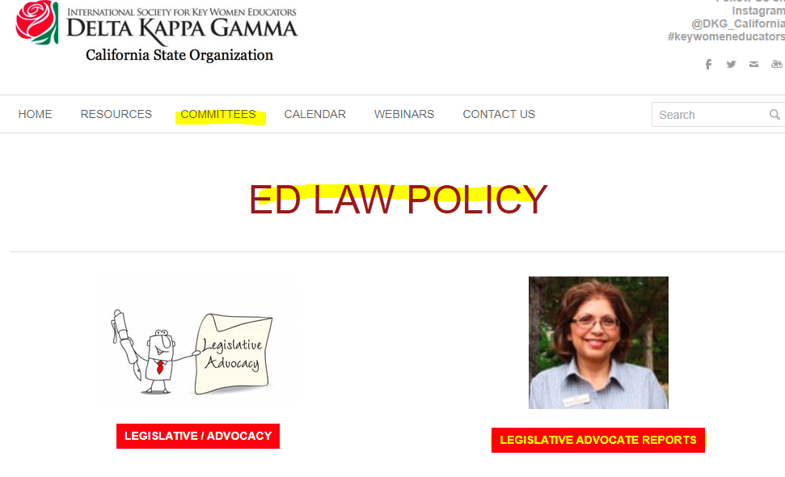
Legislative Update as of August 28, 2020
Bills DKG is following: https://drive.google.com/file/d/1JzbcZw01oPz5ZqGu_nDfBKHPFLdnmwnt/view due to COVID 19 and the downturn of California’s economy, Legislators were requested to consider moving through the legislative process only bills addressing COVID-19.
Topics include: Education finance, pupil attendance, Special Education, Advanced Placement Test Fee Reimbursement Program., changes to CALSTRS, School and community college employees: absences due to illness or accident., School employees: leaves of absence: natural disasters and evacuation orders.,
COVID-19’s Impact on Schools (https://covid19.ca.gov/education/)
On July 17, 2020, updated guidance was released for childcare, day camps, and schools. Find this guidance and more in the list of statewide guidance and checklists.
The governor’s executive order ensures that K-12 public schools will retain full funding, even if they close campuses. More than $5 billion dollars has been awarded to transitional K-12 public schools to mitigate learning loss from school closures and to support distance learning.
For current information about closures and their impact on the school year, check your local school district.
California also released guidance to help K-12 education leaders meet the needs of all students affected by school closures, with an emphasis on assisting low-income children and those with disabilities.
The California Department of Education has guidance on support for students, including:
Distance learning
School meals
Services for students with disabilities
Waived family fees for early learning and care
Updated FAQs
Schools and school districts may reopen for in-person instruction at any time if they are located in a local health jurisdiction (LHJ) that has not been on the county1 monitoring list within the prior 14 days.

Slide 14
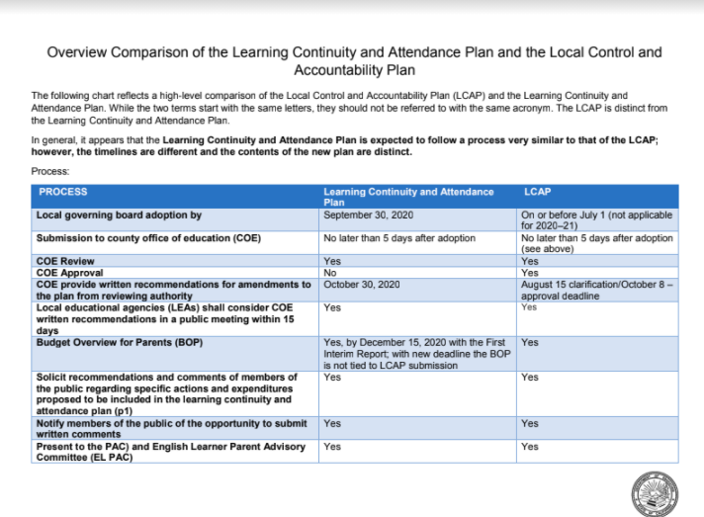

Slide 15
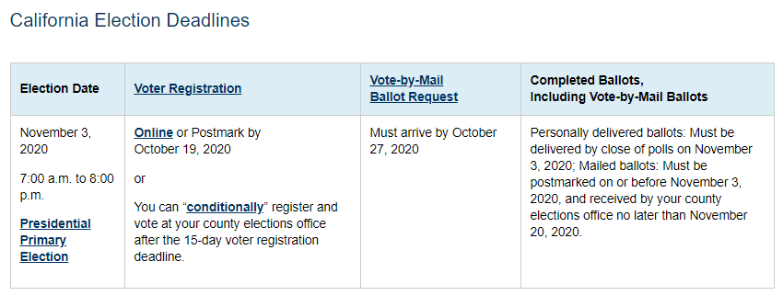
CA General Election November 3, 2020: Governor’s Executive Order N-64-20, All Voters will be mailed a vote-by-mail ballot
Official Voter Information Guide can be accessed here: https://www.sos.ca.gov/elections/upcoming-elections/general-election-november-3-2020/public-display/

Slide 16
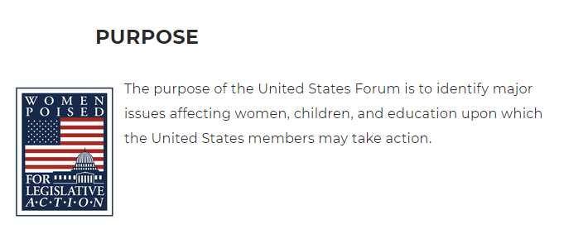
DKG US Forum
For DKG’s US Forum you can visit http://www.usforumdkg.org/
The US Forum proudly host two Facebook pages to meet our members’ needs. The Official page, The DKG US Forum page, [https://www.facebook.com/DKG.US.Forum/] and The DKG US Forum Group page [https://www.facebook.com/groups/2269724846587657/?source_id=349823881770007]

Slide 17
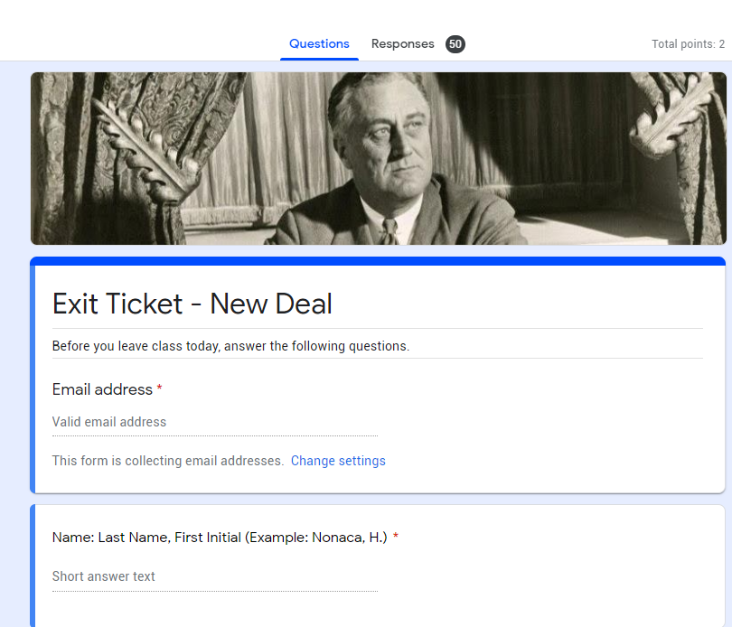
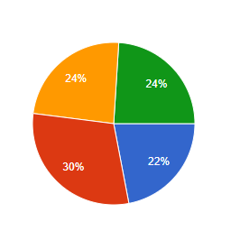
Ideas to Inspire Your Students in an Election Year
Online Navigation and Letter Writing (paragraph structure)
Have students navigate the CA Legislative website to determine who their representatives are—post in class afterwards
Have them write a letter to their reps about something that they are passionate about
Teaching Argumentation (claim and evidence)
Ask students to take a position on a California Proposition (pro and con team)
Have the class vote
Teaching Sourcing (point of view)
Have students review CA propositions in the voter guide and point out sponsoring groups to have them guess if the group is pro or con.
Giving an Informative Speech (outlining)
Have students research potential candidates on the CA ballot and give a speech/presentation about them
Teach a lesson in civics (History and Civic Responsibility)
Review voting history and voting requirements
Create a google form with CA propositions and candidates and have students vote in a mock election
Set up voting booths
Give out “I voted” stickers---share class results
Even better if done school wide
After the actual election compare school/class results to actual results and discuss
https://www.sos.ca.gov/elections/student-mock-election/california-student-mock-election
Community Service: Be a poll worker
https://www.sos.ca.gov/elections/poll-worker-information

Slide 18
Happy ‘Belated’ Constitution Day and Citizenship Day! September 17th https://www2.ed.gov/policy/fund/guid/constitutionday.html

Slide 19
Bill Evaluator Training
Interested? Contact Hazel Powell
teampowell@aol.com

Slide 20
Thanks for your attention!
Questions?
Updates?
hnonaca@gmail.com
209-324-3837

